Slide 1

Real-time Serverless: Enabling Application Performance Guarantee
Hai Duc Nguyen¹, Chaojie Zhang¹, Zhujun Xiao¹, and Andrew A. Chien^{1,2} ¹University of Chicago ²Argonne National Lab
Notes:
Explain the RTS, why it is important

Slide 2
Outline
Introduction and Motivation
Real-time Serverless
Evaluation
Implementation
Summary

Slide 3
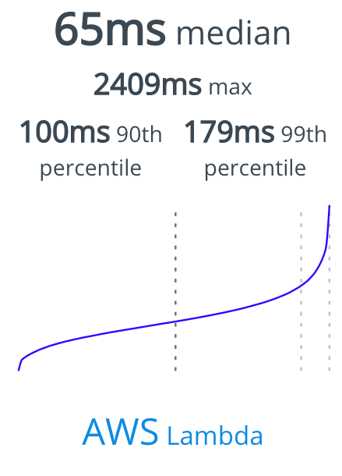
Serverless has Limitation
Function-as-a-Service (FaaS) aka Serverless is the fastest growing element of cloud workload
But
Best-effort invocations
Long-tail latency
https://serverless-benchmark.com

Slide 4
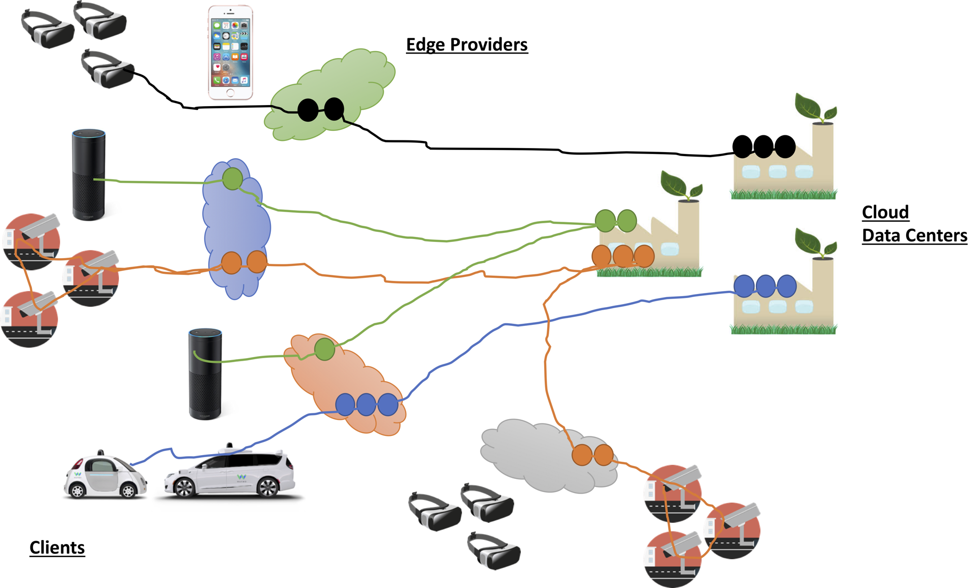
Bursty, Real-time Applications
Computation demand surges when interest events happen
A “wanted” person appears
A cyber attack
Timely response to these events
Demand
Time

Slide 5
Serverless vs. Bursty, Real-time Apps
Resource
Bursty
Load
Serverless invocations are best-effort
❌ No way to guarantee when an invocation will run
Serverless
Time

Slide 6
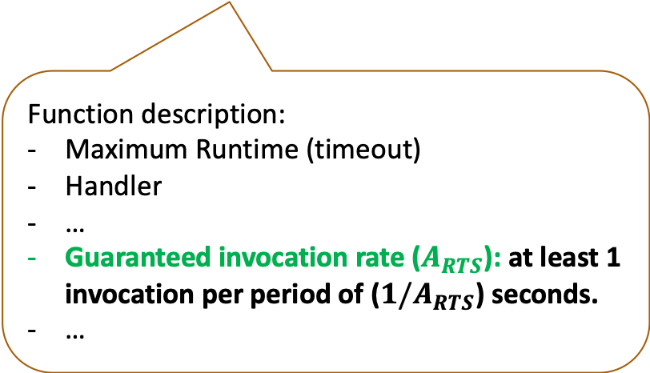
Real-time Serverless
Real-time Serverless (RTS) = Serverless + Guaranteed Invocation Rate
Resource
Deploy
Real-time
Serverless
guaranteed invocation rate
Function description:
Maximum Runtime (timeout)
Handler
…
Guaranteed invocation rate ($A_{RTS}$): at least 1 invocation per period of (${1/A}_{RTS}$) seconds.
…
10 inv. per sec
30 inv.
10 inv.
1 sec
Time
3 sec

Slide 7
Real-time Serverless
Resource
Resource
Bursty
Load
Real-time
Serverless
invocation
Serverless
Bursty
Load
Time
Time
✓ Timely resource access

Slide 8
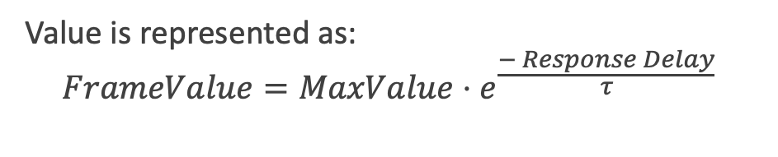

Analytic Model: Video Monitoring
Burst Duration
Burst arrival
Video Monitoring
Guaranteed Invocation
Rate ($A_{RTS}$)
Burst
Height
Camera
Response
Real-time
Serverless
Framework
Frame Value
Value is represented as: $FrameValue={MaxValue⋅e}^{\frac{− Response Delay}{τ}}$
Response Delay

Slide 9
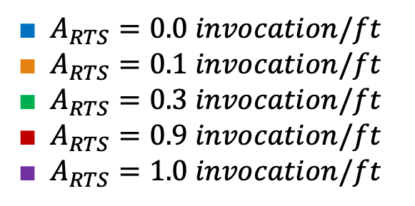
RTS Guarantees Statistics for Frame Value
100
Guarantee Invocation Rates
Better Value Distribution
■ $A_{RTS}=0.0 invocation/ft$
■ $A_{RTS}=0.1 invocation/ft$
■ $A_{RTS}=0.3 invocation/ft$
■ $A_{RTS}=0.9 invocation/ft$
■ $A_{RTS}=1.0 invocation/ft$
ft = frame-time = 1/30 sec
High guaranteed invocation rate → high value
Guarantee Statistics for Frame Value

Slide 10


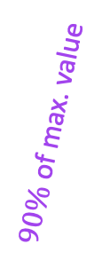
Rational Design for Value
0.92
$50\%$ of max. value
$90\%$ of max. value
$70\%$ of max. value
Application can adjust guaranteed invocation rate to meet any value target
Higher is better
Enable application to engineer the value distribution
0.86

Slide 11
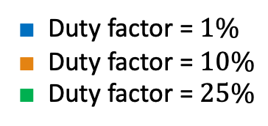
RTS with Burst Interference
■ Duty factor = $1\%$
■ Duty factor = $10\%$
■ Duty factor = $25\%$
Burst interference
Time
duty factor ↔︎ burst interference
2.5%
0.2%
For realistic bursty applications,
the interference probability is low

Slide 12
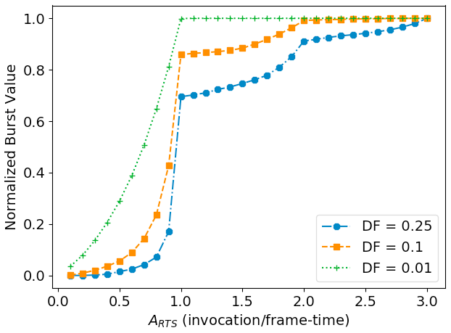
RTS can support Multiple Bursts
Bursts can happen simultaneously
Real-time Serverless can support multiple bursts
Approach is simple – just increase the guaranteed invocation rate
Higher is
better

Slide 13
Implementation
Real-time serverless interface
Compatible with serverless
Working prototype
Leverage OpenFaaS
Admission control at function registration
<function name>
lang: <Language of function body>
handler: <Location of function body>
image: <Docker image reference>
realtime: <Guaranteed invocation rate>
timeout: <Runtime limit>
limits: <Maximum resource use>
requests: <Minimum resource use>

Slide 14
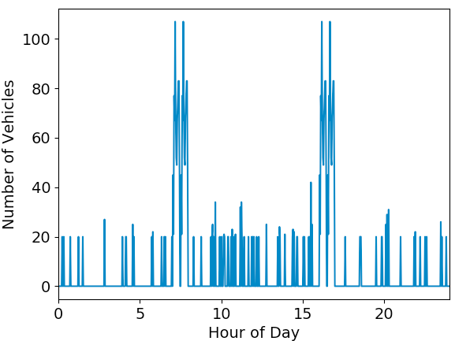
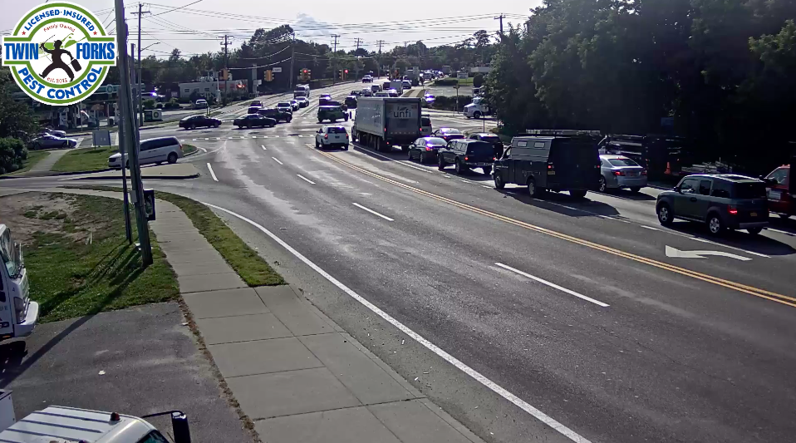
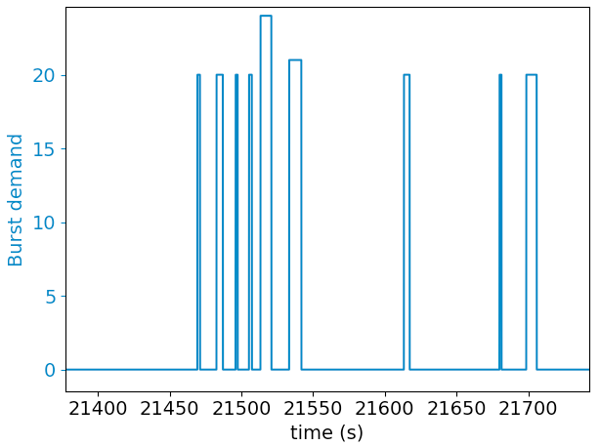
Case Study: Traffic Monitoring
Traces from real video over Glimpse
Low-level monitor for vehicle presence
Bursts arise when vehicles appears.
Rush
hours
Daytime
Night time

Slide 15
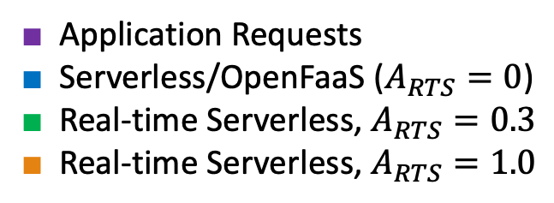
Simple Frame Value Model (Success/Fail)
Vary guaranteed invocation rate (large background load)
■ Application Requests
■ Serverless/OpenFaaS ($A_{RTS}=0$)
■ Real-time Serverless, $A_{RTS}=0.3$
■ Real-time Serverless, $A_{RTS}=1.0$
❌ Serverless cannot respond to demand changes
✓ RTS’ guarantee invocation rate enables it to respond to application demand despite competition from background load
✓ Higher RTS invocation rate improves for success rate for multiple bursts

Slide 16
Related Work
Traditional Serverless with fast, dynamic invocation
Amazon Lambda, Google Cloud Function, OpenFaaS, Knative, etc.
Minimizing FaaS invocation overhead
SAND (ATC’18), SOCK (ATC’18), Kim et. al. (CLUSTER’18).
Extension for improving FaaS performance
Jonas et. al. (SoCC’17), Hellerstein et. al. (CIDR), Jonas et. al. (Berkeley, 2019)
None focus on performance guarantees / real-time.

Slide 17
Summary
Current serverless interface cannot support real-time, bursty applications.
Real-time serverless = Serverless + Guaranteed invocation rate.
Guarantee statistics for value.
Enable rational design.
A prototype shows timely response for a video monitoring application
Future work
Efficient implementation for RTS interface
Explore the benefits of RTS interface for other application classes
Notes:
In summary,…

Slide 18
Q&A
Acknowledgement. This work supported by National Sci- ence Foundation Grants CNS-1405959, CMMI-1832230, and CNS-1901466. We gratefully acknowledge support from Intel, Google, and Samsung.

Slide 19
Backup Slides

Slide 20
A Big Picture
Cloud
Data Center
Computation
Infrastructure
Edge
Providers
Applications
IT Server
Real-time
Our focus!
Bursty
Notes:
Technology advances such as cloud as high end computing services and the emerging edge computing have enabled a wide space for the rise of many applications.

Slide 21
Real-time, Bursty Applications
Bursty: workload demand often experience bursts with…
Short duration: seconds to a few minutes
Low frequency: burst period is 10-100x longer than burst duration
Random: triggered by external causes, hard to predict
High computation demand: 10-100x or even higher than normal
Real-time: bursts is expected to be processed within a strict deadline. Application quality (or computation value) decreases rapidly as processing delay increases.

Slide 22
Validate Analytical Results with Simulation

Slide 23
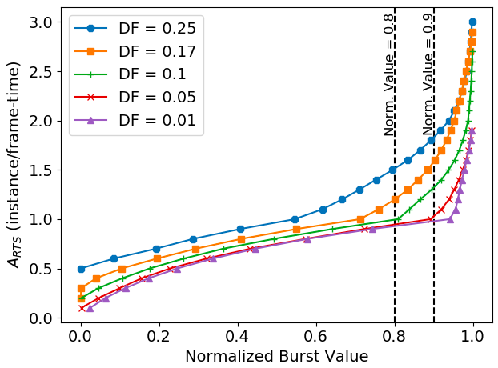
Supporting Multiple Applications

Slide 24
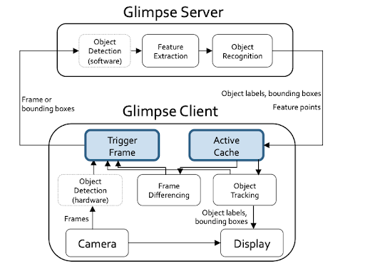
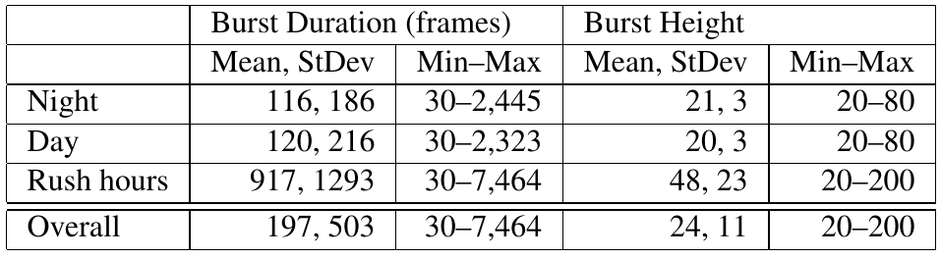
Case Study: Statistics
Burst Statistics
Glimpse Pipeline Architecture¹
¹ Tiffany Yu-Han Chen et. al., Glimpse: Continuous, Real-time Object Recognition on Mobile Devices, SenSys’15

Slide 25
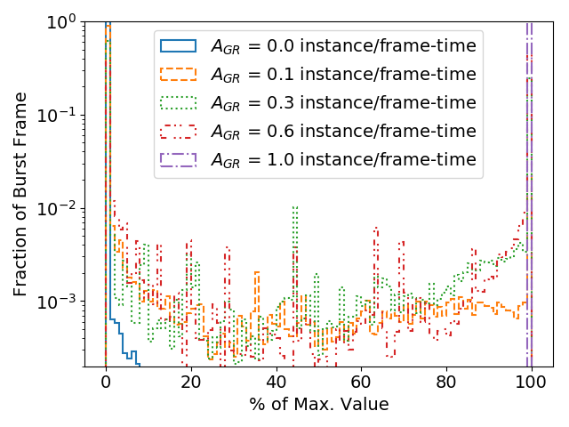
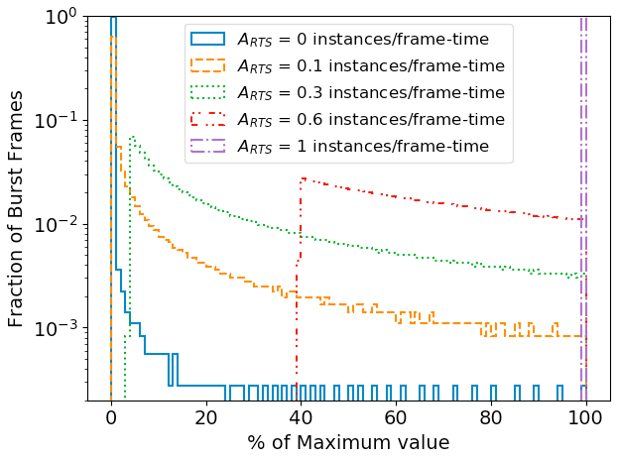
RTS for Video Analysis
Guaranteed invocation rate enables value guarantee
Realistic Workload
Synthetic Workload
Notes:
Show the graph in slide 22 for comparision,

Slide 26
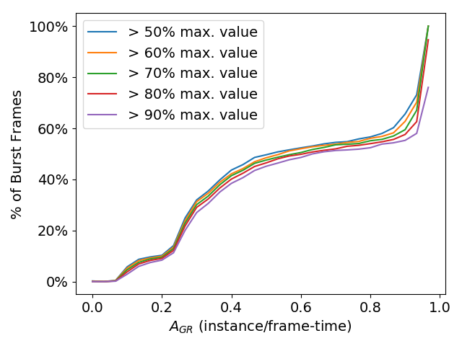
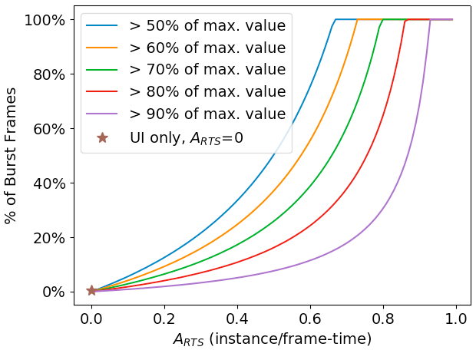
RTS for Video Analysis
Enable rational design for value guarantee
Realistic Workload
Synthetic Workload
Notes:
Show the graph in slide 22 for comparision,

Slide 27
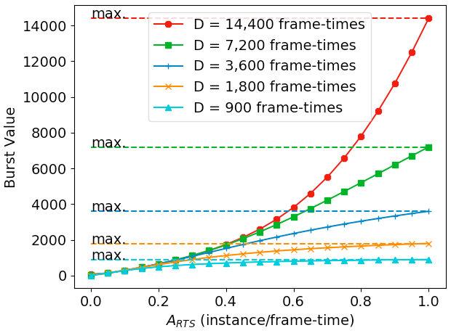
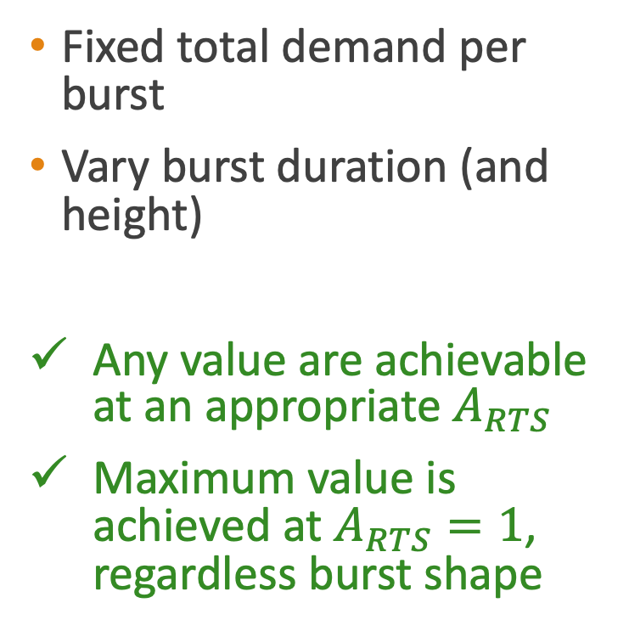
Robust against Burst Shape
Fixed total demand per burst
Vary burst duration (and height)
Any value are achievable at an appropriate $A_{RTS}$
Maximum value is achieved at $A_{RTS}=1$, regardless burst shape
Higher is
better
Notes:
X-axis – range of invocation rate
Y-axis -- burst value achieved by bursts at a given invocation rate
How sensitive the results are to the bursty properties?

Slide 28
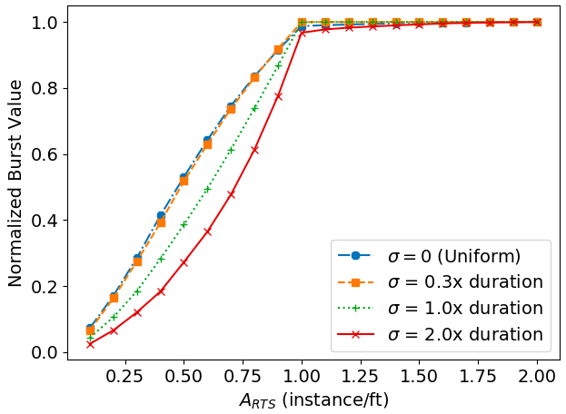
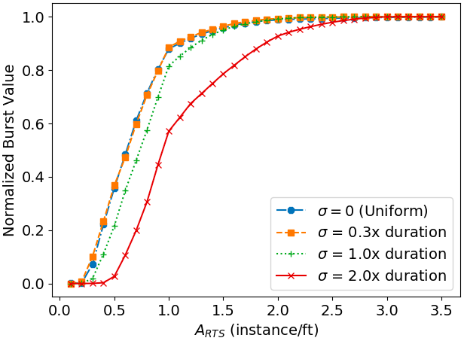
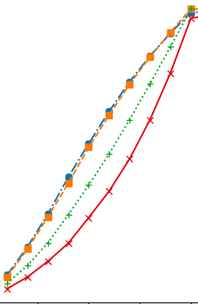
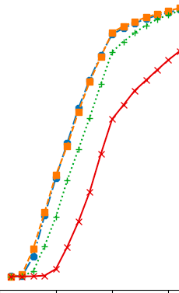
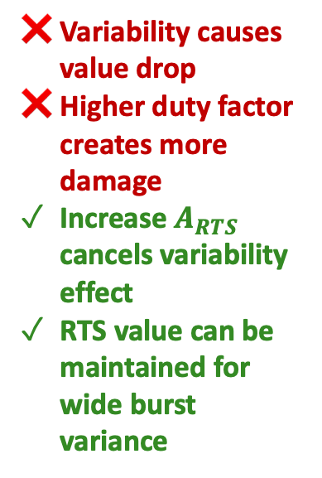
Robust against Burst Variability
Change variability by varying burst duration standard deviation
Variability causes value drop
Higher duty factor creates more damage
Increase $A_{RTS}$ cancels variability effect
RTS value can be maintained for wide burst variance
Higher is
better
0.25
0.35
27%
40%
Duty factor = 1%
Duty factor = 25%
Notes:
X-axis -- invocation rate
Y-axis – burst value normalized to maximum burst value
State that RTS is robust against burst variabliity

Slide 29
Multiple Real-time, Bursty Apps.
RTS resource cost scales with actual demand
RTS resource consumption is 2.2x to 5x lower than UI
RTS helps cloud provider save resource to serve more applications
■ Total demand
■ UI allocation
■ RTS allocation
■ RTS avg. allocation
Lower is
better
10 Apps
100 Apps

Slide 30
Application Cost: UI vs. RTS
Resource cost for maximizing burst value with different duty factors
Vary RTS vs. UI cost ratio
RTS resource value per unit cost is 16-24x higher than UI
RTS enables low cost solutions for real-time, bursty applications
Lower is
better
Notes:
X-axis: duty factor
Y-axis: total resource cost normalized to UI cost

Slide 31
UI Cost at Different Duty Factors

Slide 32
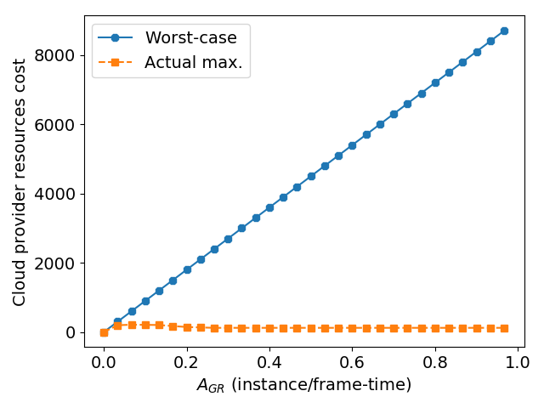
Resource Cost
Lower is
better
Lower is
better
RTS is 2x to 8x cheaper than UI
Actual resource requirement is 70x lower than the worst case

Slide 33
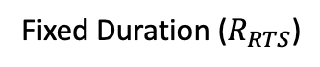
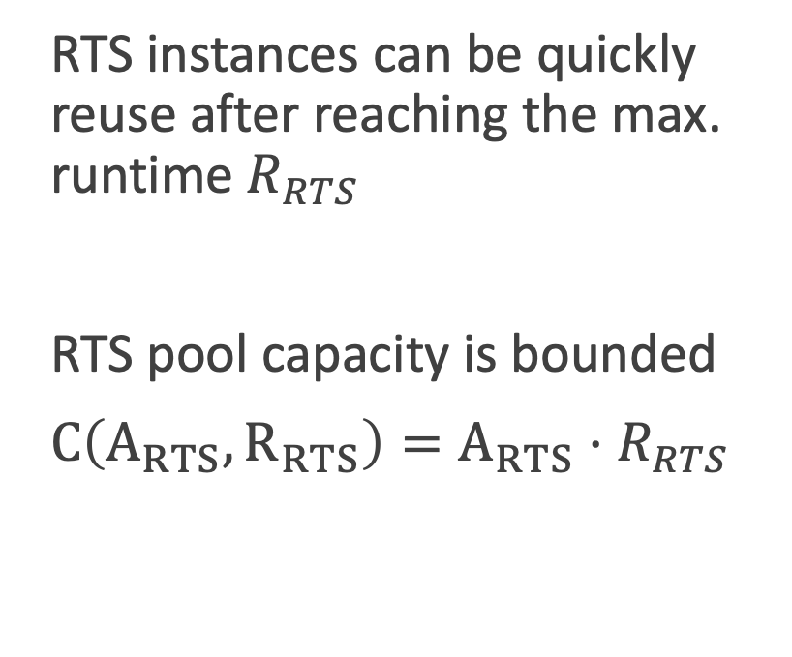
RTS Implementation Feasibility
RTS instances can be quickly reuse after reaching the max. runtime $R_{RTS}$
RTS pool capacity is bounded
$C\left(A_{RTS},R_{RTS}\right)=A_{RTS}⋅R_{RTS}$
Fixed Duration ($R_{RTS}$)
Instances Reused
Pool
Size (Size)
. . .
t

Slide 34
RTS Interface (Lambda Extension)
Function description in YAML format
<function’s name>
lang: <prog. language>
handler: <refers to a folder where function body can be found>
image: <Docker image reference>
realtime: <minimum invocation rate>
environment:
exec_timeout: <Hard processing timeout>
limits: # <---- Maximum resources used by the function
memory: <max. memory>
cpu: <max. cpu>
requests: # <---- Resource requested by an instance
memory: <req. memory>
cpu: <req. cpu>
RTS Extension

Slide 35
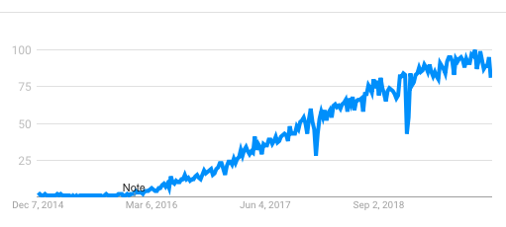
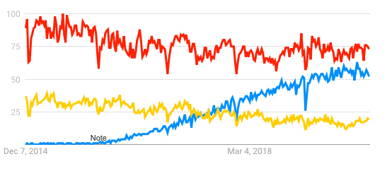
Introduction
Function-as-a-Service (FaaS) aka Serverless is the fastest growing element of cloud workload
Expected to the the driving force for the future cloud computing
Easy for development and deployment
Dynamic resource scaling enables cost efficiency
High resource management flexibility
■ Serverless
■ Virtualization
■ MapReduce

Slide 36
Demonstration: Experiment setup
RS
Serverless
Real-time Serverless
Serverless
(best-effort)
Serverless
(best-effort)
Background load generator
Driver
Image viewer
Driver
Image viewer
Streaming app
Streaming app

